Slide 1

Scalable Data Analytics Using R: Single Machines to Spark Clusters
John-Mark Agosta, Hang Zhang, Robert Horton, Mario Inchiosa, Srini Kumar, Mengyue (Katherine) Zhao, Vanja Paunic and Debraj GuhaThakurta
Microsoft
TUTORIAL MATERIAL & SLIDES: tinyurl.com/KDD2016R
ROOM: Embarcadero
Parc 55 San Francisco,
55 Cyril Magnin St, San Francisco, CA
TIME: 9:00am - 12:00pm
August 17th, 2016, KDD 2016, San Francisco
2016

Slide 2
Tutorial Outline
Introduction - scaling your R scripts (issues and solutions)
Hands-on tutorial (end-to-end scalable data analysis in R)
Practical examples and case studies
Q&A

Slide 3
Introduction - Scaling your R scripts
2016
Katherine Zhao
Microsoft

Slide 4
Introduction
What is R?
What limits the scalability of R scripts?
What functions and techniques can be used to overcome those limits?
How do the base and scalable approaches compare?

Slide 5

What is
Language
Platform
The most popular statistical programming language
A data visualization tool
Open source
Community
2.5+M users
Taught in most universities
New and recent grad’s use it
Thriving user groups worldwide
Ecosystem
8000+ contributed packages
Rich application & platform integration

Slide 6
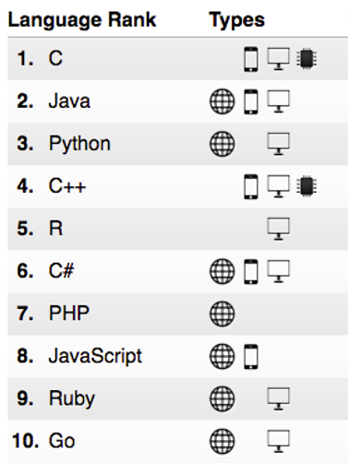
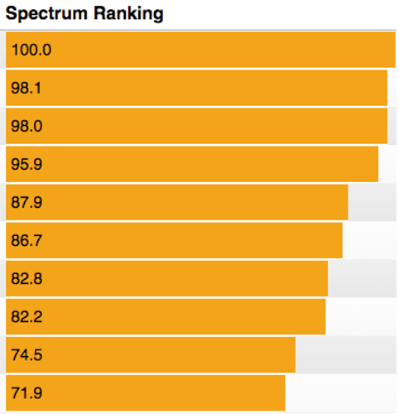
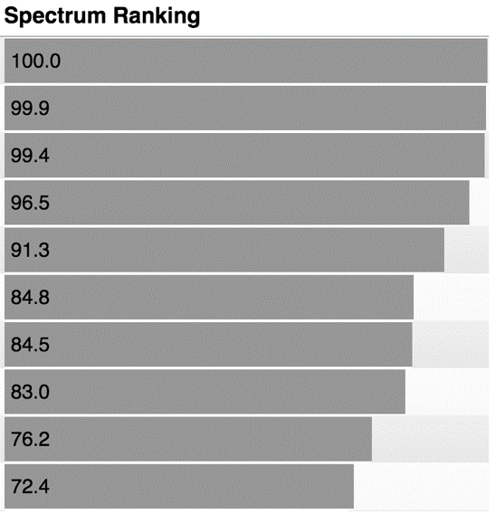
R ranks #5 in IEEE Spectrum July 2016
2016
2015

Slide 7
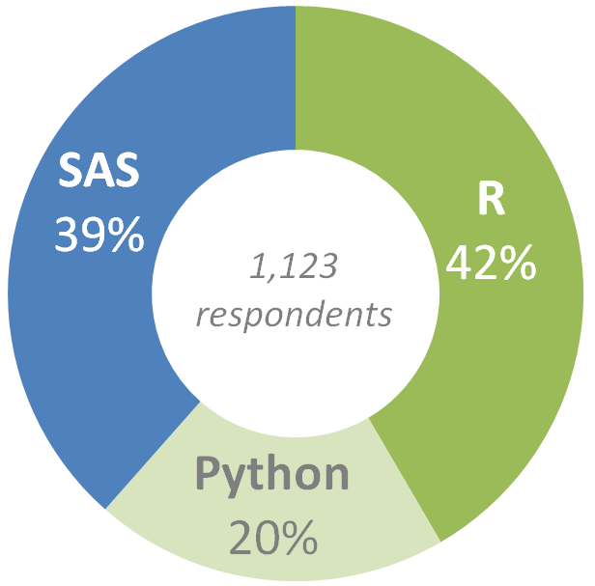
Preferred language by Analytics Pros
Which do you prefer to use: SAS, R, or Python?
Source: SAS, R or Python Survey 2016, by Burtch Works

Slide 8
Common R use cases
Vertical | Sales & Marketing | Finance & Risk | Customer & Channel | Operations & Workforce
Retail | Demand Forecasting Loyalty Programs Cross-sell & Upsell Customer Acquisition | Fraud Detection Pricing Strategy | Personalization Lifetime Customer Value Product Segmentation | Store Location Demographics Supply Chain Management Inventory Management
Financial Services | Customer Churn Loyalty Programs Cross-sell & Upsell Customer Acquisition | Fraud Detection Risk& Compliance Loan Defaults | Personalization Lifetime Customer Value | Call Center Optimization Pay for Performance
Healthcare | Marketing Mix Optimization Patient Acquisition | Fraud Detection Bill Collection | Population Health Patient Demographics | Operational Efficiency Pay for Performance
Manufacturing | Demand Forecasting Marketing mix Optimization | Pricing Strategy Perf Risk Management | Supply Chain Optimization Personalization | Remote Monitoring Predictive Maintenance Asset Management

Slide 9
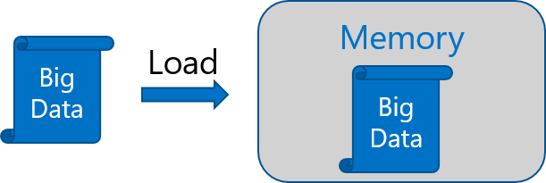
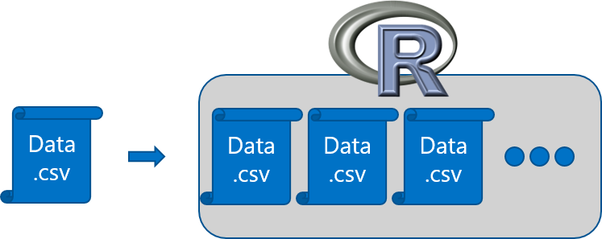
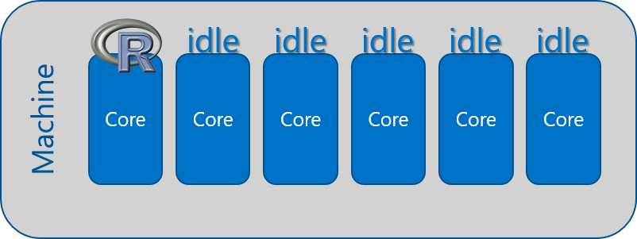
R adoption is on a Tear
In-Memory Operation
Expensive Data Movement
& Duplication
Lack of Parallelism

Slide 10



Open source R is not enterprise class
Inadequacy of Community Support
Lack of Guaranteed Support Timeliness
No SLAs or Support Models

Slide 11
Couple of scalable R solutions
Choose R packages with big data support on single machines
The “bigmemory” project
“ff” and related packages
Scale from single machines to distributed computing
SparkR
sparklyr
RevoScaleR (Microsoft R Server)
and more!

Slide 12
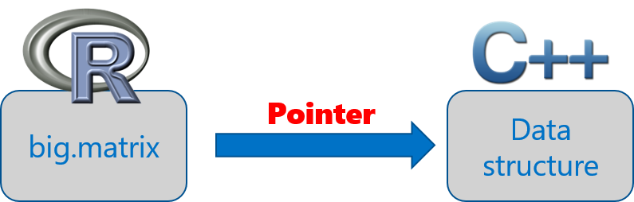
The bigmemory project
Coined by Michael Kane and John Emerson at Yale University
“bigmemory” works with massive matrix-like objects in R
Combines memory and file-backed data structures: analyze numerical data larger than RAM
The data structures may be allocated to shared memory
Source: “The Bigmemory Project” by Michael Kane and John Emerson: April 29, 2010.

Slide 13
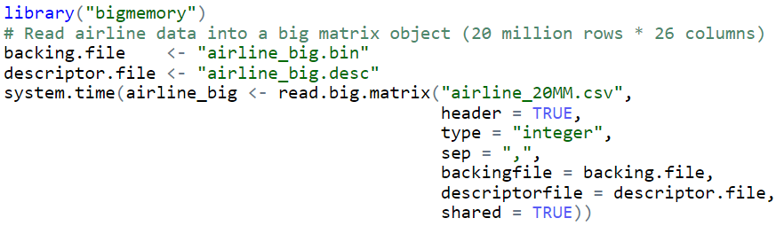
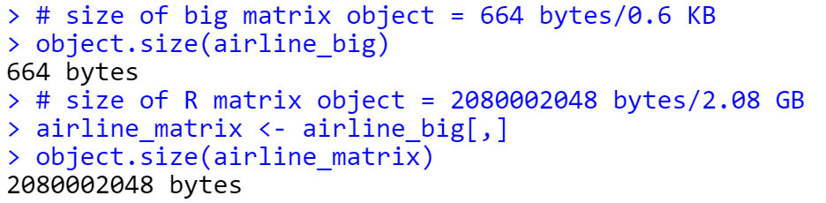
Brings a small object into memory
Imports a 20 million rows * 26 columns numerical matrix
big.matrix object is much smaller than its corresponding R matrix

Slide 14
Sister packages and related work
Set of packages that extends the R programming environment
biganalytics: provides exploratory data analysis functionality on big.matrix
bigtabulate: adds table-, tapply-, and split-like behavior for big.matrix
bigalgebra: performs linear algebra calculations on big.matrix and R matrix
synchronicity: supports synchronization and may eventually support interprocess communication (ipc) and message passing
Other related packages
biglm: provides linear and generalized linear models on big.matrix
Rdsm: enables shared-memory parallelism with big.matrix
Source: “The Bigmemory Project” by Michael Kane and John Emerson: April 29, 2010.

Slide 15
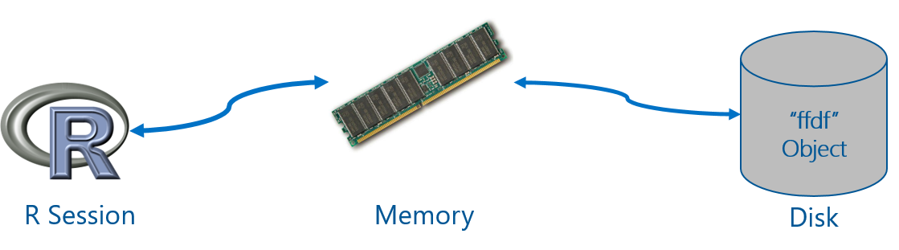
“ff” package
Provides data structures that are stored on Disk, but behave as if they were in RAM
Maps only a section in main memory for effective consumption
Accepts numeric and characters as input data
Source: ff: memory-efficient storage of large data on disk and fast access functions.

Slide 16
ffdf separates virtual from physical storage
data.frame(matrix)
ffdf(ff_matrix)
matrix
ff_matrix
physically not copied (default)
copied to vectors
virtually mapped
Source: Managing data.frames with package 'ff' and fast filtering with package 'bit‘, by Oehlschlägel, Adler (2009).

Slide 17
“ff” related packages
ffbase: adds basic statistical functionality to ff. (Note: *.ff apply on ff vectors, and *.ffdf apply on ffdf.)
Coercions: as.character.ff(), as.Date_ff_vector(), as.ffdf.ffdf(), as.ram.ffdf()
Selections: subset.ffdf(), ffwhich(), transform.ffdf(), within.ffdf(), with.ffdf()
Aggregations: quantile.ff(), hist.ff(), sum.ff(), mean.ff(), range.ff(), tabulate.ff()
Algorithms: bigglm.ffdf()
biglars: provides least-angle regression, lasso and stepwise regression on ff.
Source: CRAN Task View: High-Performance and Parallel Computing with R, by Dirk Eddelbuettel.

Slide 18
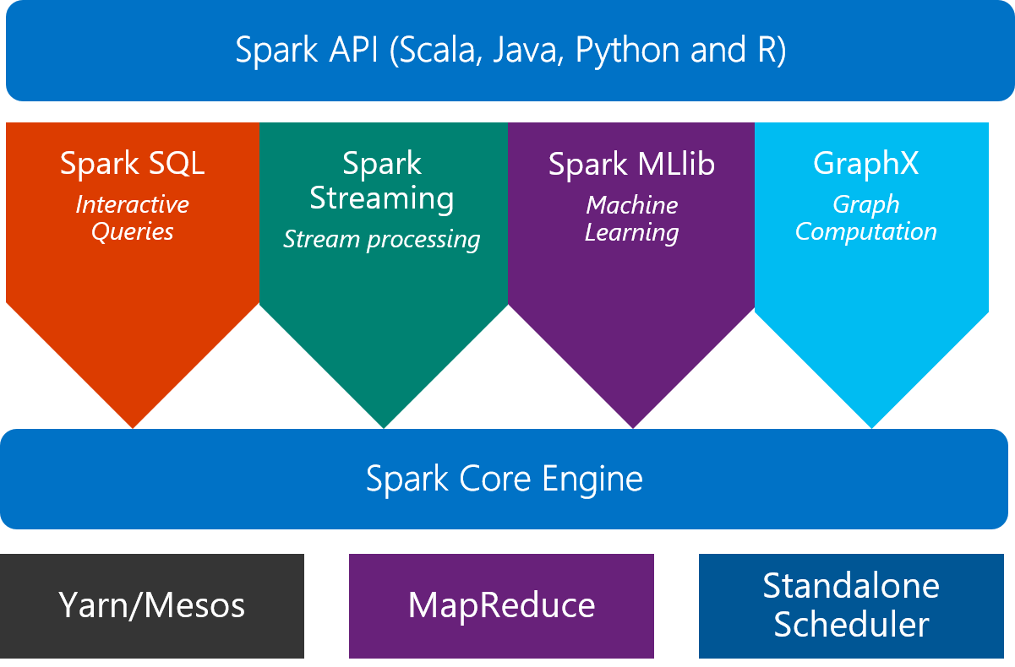
From single machines to distributed computing
Scale on Spark clusters is one approach
What is Spark?
An unified, open source, parallel, data processing framework for Big Data Analytics

Slide 19
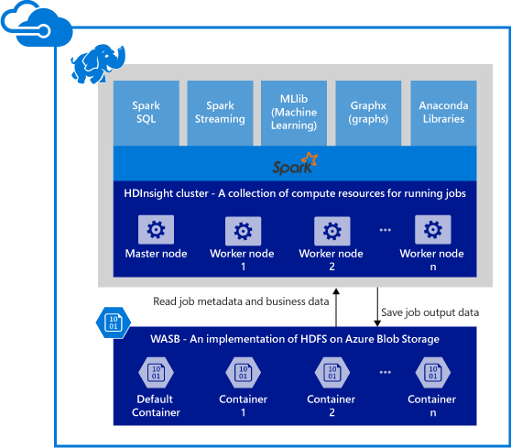
Spark clusters in Azure HDInsight
Provisions Azure compute resources with Spark 1.6 installed and configured.
Data is stored in Azure Blob storage (WASB).

Slide 20

SparkR 1.6: a Spark API
An R package provides a light-weight frontend to use Apache Spark from R and allows data scientists to analyze large datasets.
Spark DataFrame is distributed collection of data organized into named columns.
With SQLContext, SparkR can create Spark DataFrames from local R data frames, csv, json and parquet files.
Using HiveContext, it can also access tables from Hive MetaStore.
Pre-configured on Spark clusters in HDInsight.

Slide 21
Data processing and modeling with SparkR
Supports functions for structured data processing:
Selections: select(), filter()
Aggregations: summarize(), arrange()
Applying UDFs on each partition of a SparkDataFrame: available in SparkR 2.0!
dapply(), dapplyCollect(), gapply(), gapplyCollect()
Uses MLlib to fit generalized linear models over SparkDataFrames
More algorithms and model persistence are included in SparkR 2.0
Accelerated Failure Time (AFT) Survival Regression Model
Naive Bayes Model
KMeans Model

Slide 22
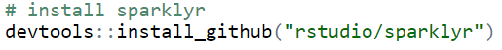
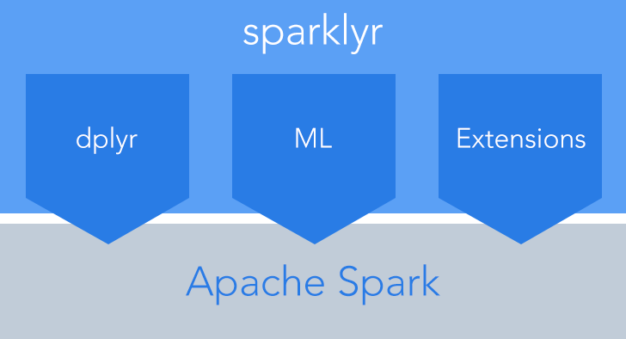
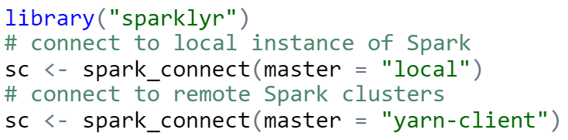
sparklyr: R interface for Apache Spark
Easy installation via devtools
Connect to both local instances of Spark and remote Spark clusters
Loads data into Spark DataFrames from: local R data frames, Hive tables, CSV, JSON, and Parquet files.
Source: http://spark.rstudio.com/

Slide 23
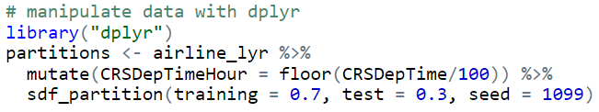
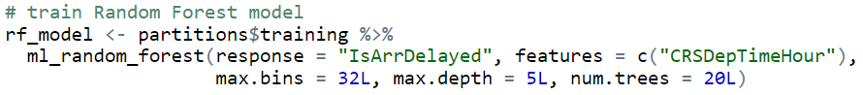
dplyr and ML in sparklyr
Provides a complete dplyr backend for data manipulation, analysis and visualization
%>%
Includes 3 family of functions for machine learning pipeline
ml_*: Machine learning algorithms for analyzing data provided by the spark.ml package.
K-Means, GLM, LR, Survival Regression, DT, RF, GBT, PCA, Naive-Bayes, Multilayer Perceptron
ft_*: Feature transformers for manipulating individual features.
sdf_*: Functions for manipulating SparkDataFrames.

Slide 24
R Server: scale-out R, Enterprise Class!
100% compatible with open source R
Any code/package that works today with R will work in R Server.
Ability to parallelize any R function
Ideal for parameter sweeps, simulation, scoring.
Wide range of scalable and distributed “rx” pre-fixed functions in “RevoScaleR” package.
Transformations: rxDataStep()
Statistics: rxSummary(), rxQuantile(), rxChiSquaredTest(), rxCrossTabs()…
Algorithms: rxLinMod(), rxLogit(), rxKmeans(), rxBTrees(), rxDForest()…
Parallelism: rxSetComputeContext()

Slide 25










Parallelized & Distributed Analytics
ETL
Statistical Tests
Machine Learning
Data import – Delimited, Fixed, SAS, SPSS, OBDC
Variable creation & transformation
Recode variables
Factor variables
Missing value handling
Sort, Merge, Split
Aggregate by category (means, sums)
Chi Square Test
Kendall Rank Correlation
Fisher’s Exact Test
Student’s t-Test
Decision Trees
Decision Forests
Gradient Boosted Decision Trees
Naïve Bayes
Predictive Statistics
Clustering
Sum of Squares (cross product matrix for set variables)
Multiple Linear Regression
Generalized Linear Models (GLM) exponential family distributions: binomial, Gaussian, inverse Gaussian, Poisson, Tweedie. Standard link functions: cauchit, identity, log, logit, probit. User defined distributions & link functions.
Covariance & Correlation Matrices
Logistic Regression
Predictions/scoring for models
Residuals for all models
K-Means
Descriptive Statistics
Sampling
Min / Max, Mean, Median (approx.)
Quantiles (approx.)
Standard Deviation
Variance
Correlation
Covariance
Sum of Squares (cross product matrix for set variables)
Pairwise Cross tabs
Risk Ratio & Odds Ratio
Cross-Tabulation of Data (standard tables & long form)
Marginal Summaries of Cross Tabulations
Subsample (observations & variables)
Random Sampling
Simulation
Simulation (e.g. Monte Carlo)
Parallel Random Number Generation
Custom Parallelization
Variable Selection
rxDataStep
rxExec
PEMA-R API
Stepwise Regression

Slide 26
Portable across multiple platforms
Windows
Linux
HDInsight
Cloud
Hortonworks
Cloudera
MapR
Hadoop & Spark
R Server Technology
R Server portfolio
EDW
SQL Server 2016
Teradata Database
R+CRAN
Microsoft R Open
DeployR
DistributedR
RDBMS
SQL Server 2016 EE
SQL Server 2016 SE
ConnectR
Desktops & Servers
Windows
Linux
ScaleR

Slide 27
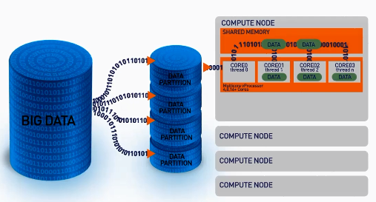
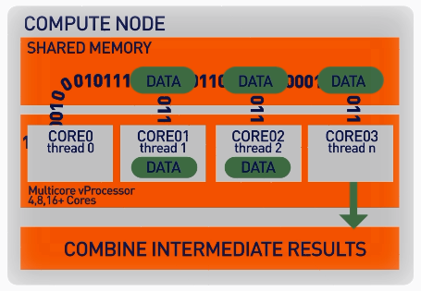
ScaleR: parallel + Big Data
Our ScaleR algorithms work inside multiple cores / nodes in parallel at high speed
Stream data into RAM in blocks. “Big Data” can be any data size. We handle Megabytes to Gigabytes to Terabytes…
Interim results are collected and combined analytically to produce the output on the entire data set
XDF file format is optimised to work with the ScaleR library and significantly speeds up iterative algorithm processing.

Slide 28
Write Once - Deploy Anywhere
ScaleR models can be deployed from a server or edge node to run in Spark/Hadoop without any functional R model re-coding.
Local Parallel processing - Linux or Windows
In – Spark/Hadoop
### SETUP LOCAL ENVIRONMENT VARIABLES ###
myLocalCC <- “localpar”
### LOCAL COMPUTE CONTEXT ###
rxSetComputeContext(myLocalCC)
### CREATE LINUX, DIRECTORY AND FILE OBJECTS ###
linuxFS <- RxNativeFileSystem( )
AirlineDataSet <- RxXdfData(“airline_20MM.xdf”,
fileSystem = linuxFS)
### SETUP SPARK/HADOOP ENVIRONMENT VARIABLES ###
mySparkCC <- RxSpark() myHadoopCC <- RxHadoopMR()
### HADOOP COMPUTE CONTEXT ###
rxSetComputeContext(mySparkCC) rxSetComputeContext(myHadoopCC)
### CREATE HDFS, DIRECTORY AND FILE OBJECTS ###
hdfsFS <- RxHdfsFileSystem()
AirlineDataSet <- RxXdfData(“airline_20MM.xdf”, fileSystem = hdfsFS)
Compute context R script - sets where the model will run
Functional model R script – does not need to change to run in Spark
### ANALYTICAL PROCESSING ###
### Statistical Summary of the data
rxSummary( ~ ArrDelay + DayOfWeek, data = AirlineDataSet, reportProgress = 1)
### CrossTab the data
rxCrossTabs(ArrDelay ~ DayOfWeek, data = AirlineDataSet, means = T)
### Linear model and plot
hdfsXdfArrLateLinMod <- rxLinMod(ArrDelay ~ DayOfWeek + CRSDepTime, data = AirlineDataSet)
plot(hdfsXdfArrLateLinMod$coefficients)

Slide 29
Base and scalable approaches comparison
Approach | Scalability | Spark | Hadoop | SQL | Teradata | Support
CRAN R1 | Single machines |  |  |  |  | Community
bigmemory | Single machines |  |  |  |  | Community
ff | Single machines |  |  |  |  | Community
SparkR | Single + Distributed computing | X |  | X |  | Community
sparklyr | Single + Distributed computing | X |  | X |  | Community
RevoScaleR | Single + Distributed computing | X | X | X | X | Enterprise
CRAN R indicates no additional R packages installed

Slide 30
R Server on Spark - faster and more scalable
Configuration:
HDI cluster size: 7 nodes
1 Edge Node: 8 cores, 28GB
4 Worker Nodes: 8 cores, 28GB
Dataset: Duplicated Airlines data (.csv)
Number of columns: 26

Slide 31
R Server on Spark - substantially faster
Configuration:
HDI cluster size: 7 nodes
1 Edge Node: 8 cores, 28GB
4 Worker Nodes: 8 cores, 28GB
Dataset: Duplicated Airlines data (.csv)
Number of columns: 26

Slide 32
Hands-on Tutorial: Airline Arrival Delay Prediction using R Server and Spark
2016
Mario Inchiosa
Microsoft

Slide 33


R Server Hadoop Architecture
1. R Server Local Processing:
Data in Distributed Storage
R process on Edge Node
Data Scientists
Edge Node
Data Nodes
R
R
R
R
R
Head Nodes
2. R Server Distributed Processing:
Master R process on Edge Node
Apache YARN and Spark
Worker R processes on Data Nodes
R
R
R
R
R
Microsoft R Server

Slide 34
R Server on Hadoop/HDInsight scales to hundreds of nodes, billions of rows and terabytes of data
2.2 TB

Slide 35
Typical advanced analytics lifecycle
Prepare: Assemble, cleanse, profile and transform diverse data relevant to the subject.
Model: Use statistical and machine learning algorithms to build classifiers and regression models
Operationalize: Make predictions and visualizations to support business applications
Prepare
Model
Operationalize

Slide 36
Airline Arrival Delay Prediction Demo
Clean/Join – Using SparkR from R Server
Train/Score/Evaluate – Scalable R Server functions
Deploy/Consume – Using AzureML from R Server

Slide 37
Airline data set
Passenger flight on-time performance data from the US Department of Transportation’s TranStats data collection
>20 years of data
300+ Airports
Every carrier, every commercial flight
http://www.transtats.bts.gov

Slide 38
Weather data set
Hourly land-based weather observations from NOAA
> 2,000 weather stations
http://www.ncdc.noaa.gov/orders/qclcd/

Slide 39
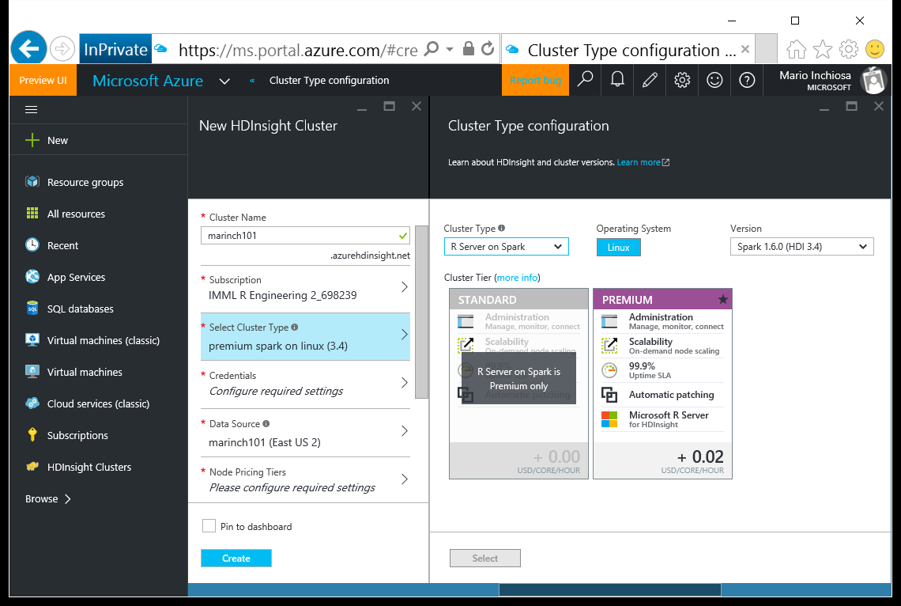
Provisioning a cluster with R Server

Slide 40
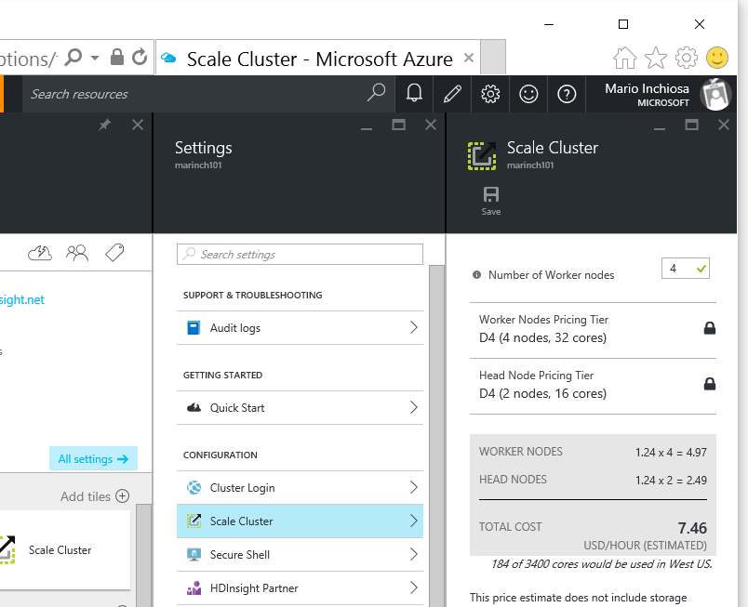
Scaling a cluster

Slide 41
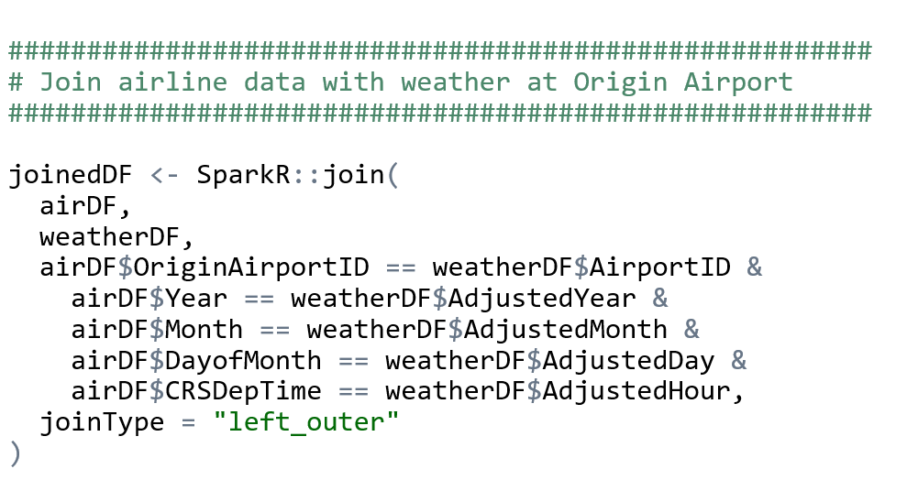
Clean and Join using SparkR in R Server

Slide 42
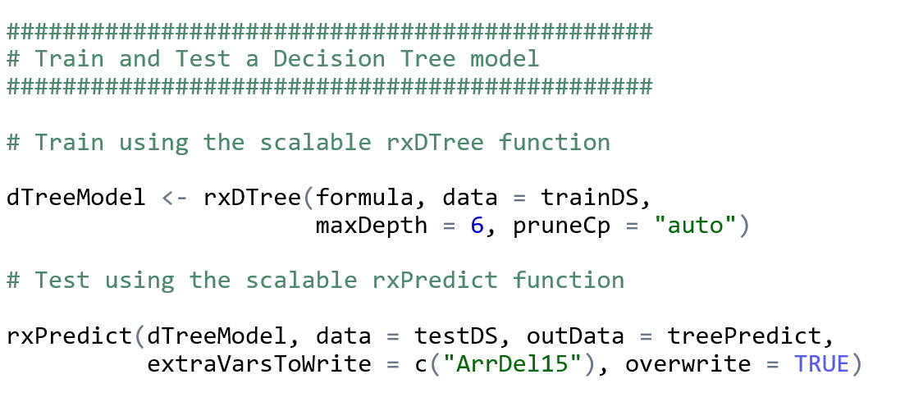
Train, Score, and Evaluate using R Server

Slide 43
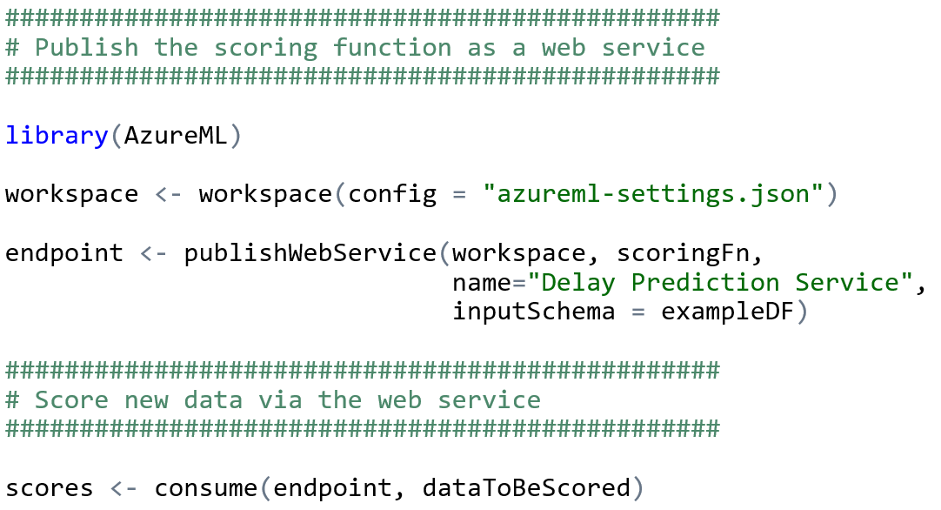
Publish Web Service from R

Slide 44
Demo Technologies
HDInsight Premium Hadoop cluster
Spark on YARN distributed computing
R Server R interpreter
SparkR data manipulation functions
RevoScaleR Statistical & Machine Learning functions
AzureML R package and Azure ML web service

Slide 45
For more information…
R Server
microsoft.com/r-server
HDInsight Premium
microsoft.com/hdinsight

Slide 46
Hands-on Tutorial: Using SparkR and sparklyr with 2013 NYCTaxi Data
Hang Zhang
Debraj GuhaThakurta
Microsoft
2016

Slide 47
Demo

Slide 48
Practical examples and case studies
Exploration and visualization using SparkSQL and R
Parallel models: training many parallel models for hierarchical time series optimization
Distributed model training and parameter optimization: Learning Curves on Big Data
Overview of open libraries of R templates and examples

Slide 49
Exploration and Visualization using SparkSQL and R
2016
Srini Kumar
Microsoft

Slide 50
Demo

Slide 51
Parallel models: training many parallel models for hierarchical time series optimization
Vanja Paunić
John-Mark Agosta
Microsoft
2016

Slide 52
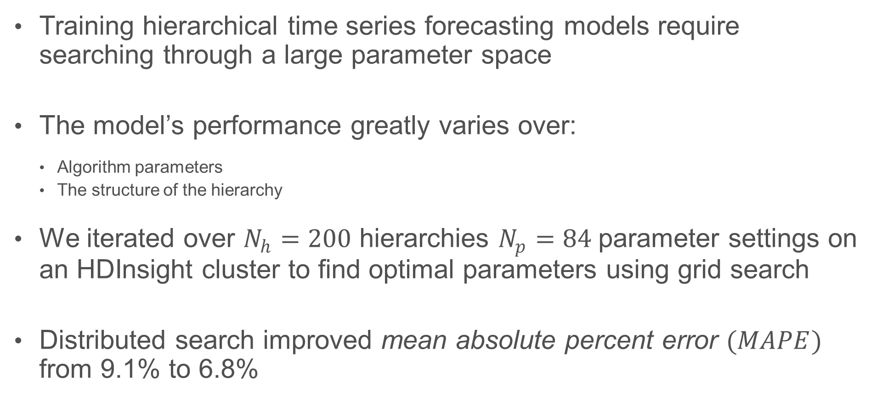
Motivation
Training hierarchical time series forecasting models require searching through a large parameter space
The model’s performance greatly varies over:
Algorithm parameters
The structure of the hierarchy
We iterated over $N_{h}=200$ hierarchies $N_{p}=84$parameter settings on an HDInsight cluster to find optimal parameters using grid search
Distributed search improved mean absolute percent error $(MAPE)$ from 9.1% to 6.8%

Slide 53
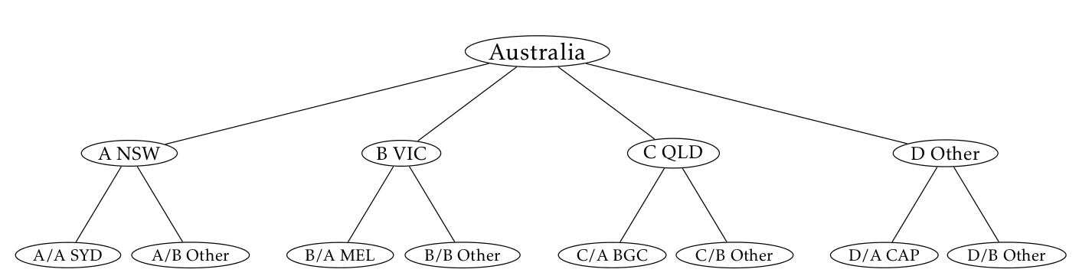
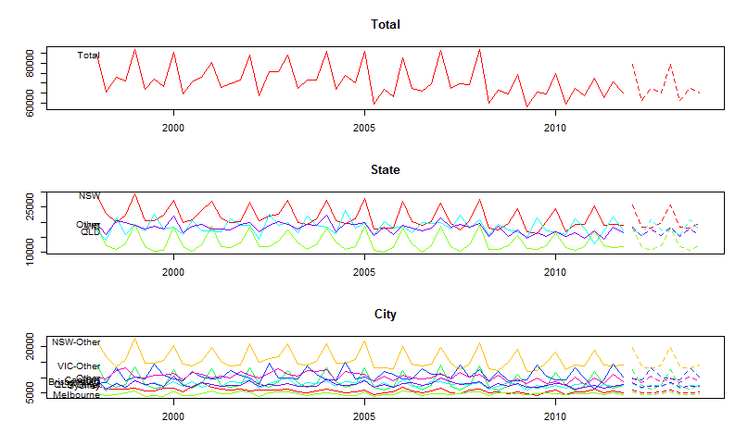
Hierarchical Time Series (HTS) Example
Australian tourism data set
Forecasting nights spent by tourists in Australia:
In total
By state
By city
Several approaches:
Bottom up
Top down
Middle out
Combination
Image source: https://www.otexts.org/fpp/9/4

Slide 54
Real life example
Customer demand forecasting disaggregated by eight variables
Middle out approach
Hierarchical time series forecasting to level L, then disaggregate the forecast down using historical proportions
Total
Customer 1
CT1
CT2
Customer 2
CT1
Aggregate
By Customer
By Container
By Destination
CT2
…
US
China
…
US
China
…
…
By Origin
…
…
…
…
…
….
…
…
…
(FOUR more variables / levels)

Slide 55
Search space complexity
Search space:
Algorithm parameters
The structure of the hierarchy
Total search space ~17000!
HPC rather than Big Data problem
Small cluster suffices
HDInsight cluster with 4 nodes, 32 cores
ts_method <- c("arima", "ets", "rw")
hts_method <- c("bu", "comb", "tdgsa", "tdgsf", "tdfp")
comb_hts_weights <- c("sd", "none", "nseries”)
hist_prop_window <- c(3, 6, 9, 12)
Customer
Commodity
Commodity

Slide 56
Iterative optimization
Iterative optimization made the search space tractable
Default settings
Vary parameters
MAPE
Baseline
MAPE = 9.1%
MAPE
Vary hierarchy

Slide 57
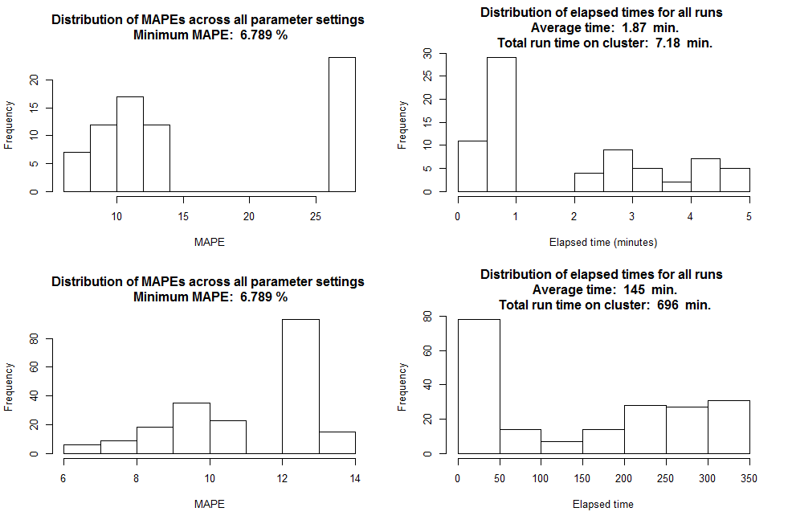
RESULTS (LAST ROUND) DEFAULT HIERARCHY VARYING PARAMETERS Minimum MAPE: 6.789 % Optimal historical window for top-down proportions: 3 months Optimal method for distributing forecasts within the hierarchy: Bottom-up Optimal forecasting method: Arima Number of jobs: 84 Total execution time: 7.183 min. Average run execution time: 1.872 min. DEFAULT PARAMETERS VARYING HIERARCHY Minimum obtained MAPE: 6.789 % Best vars to run statistical forecast on: Commodity, Container Number of jobs: 200 Total execution time: 695.7 min. Average run execution time: 144.6 min.

Slide 58
Results
MAPE improved from 9.1% to 6.8%
Total execution time ~1 day, if ran serially it would take ~40 days
Optimal result was counterintuitive compared to the initial guess
“Middle-out” approach avoids problems with highly disaggregated time series
Conclusion
R Server on HDInsight cluster allows for an efficient search of the parameter grid to find optimal model parameters
For many HPC problems, a small cluster may be sufficient

Slide 59
Reference
Sample demo on the tutorial github: sample_demo.R
http://tinyurl.com/KDD2016RCode/UseCaseHTS
HDInsight
https://azure.microsoft.com/en-us/services/hdinsight/
Hyndman, R.J. and Athanasopoulos, G. (2013) Forecasting: principles and practice. OTexts: Melbourne, Australia. http://otexts.org/fpp/.

Slide 60
Distributed model training and parameter optimization: Learning Curves on Big Data
2016
Robert Horton
Microsoft

Slide 61
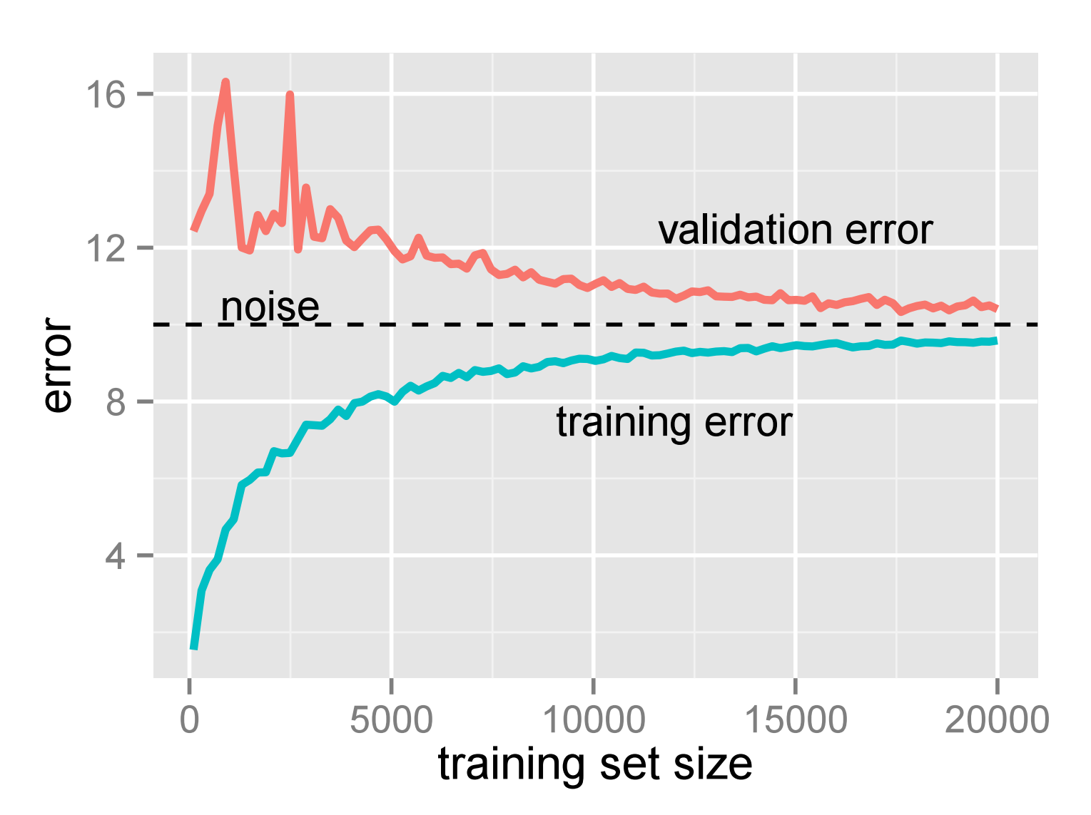
Learning Curve

Slide 62
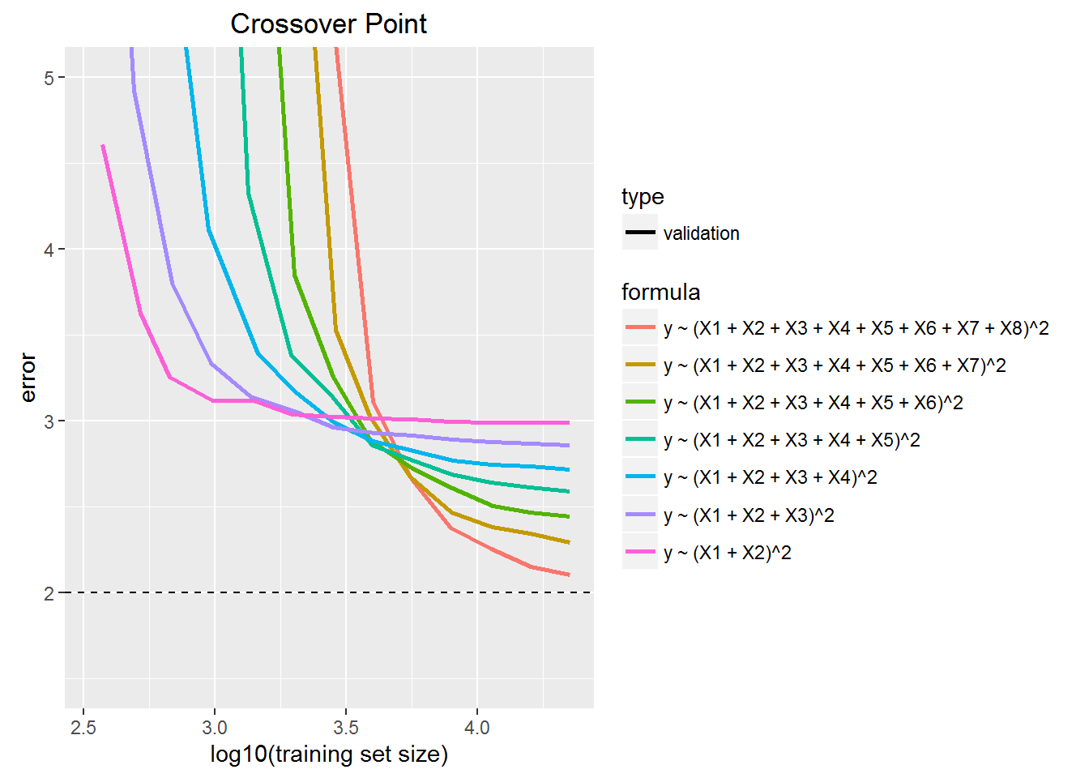
From blog post “Learning from Learning Curves”

Slide 63
Demo

Slide 64
sim_data
Inputs:
x1 = sample(categories, N, replace=TRUE)
Outcomes:
y1 = 100 + ifelse(x1==x2, 10, 0) + rnorm(N, sd=noise),
y2 = 100 +
ifelse(x1==x2, 16, 0) +
ifelse(x3==x4, 8, 0) +
ifelse(x5==x6, 4, 0) +
ifelse(x7==x8, 2, 0) +
rnorm(N, sd=noise),
bad_widget = y2 > threshold

Slide 65
Dynamic Sampling
row_tagger:
set.seed(chunk_num + salt)
kfold <- sample(1:kfolds, size=num_rows,
replace=TRUE)
in_test_set <- kfold == kfold_id
num_training_candidates <- sum(!in_test_set)
keepers <- sample(rowNums[!in_test_set],
prob * num_training_candidates)
data_list$in_training_set <- rowNums %in% keepers
data_list$in_test_set <- in_test_set

Slide 66
Dynamic Scoring
On each chunk:
residual <- rxPredict(model, <selected cases>)
SSE <- SSE + sum(residual^2, na.rm=TRUE)
rowCount <- rowCount + sum(!is.na(residual))
On overall results:
sqrt(SSE/rowCount)) # root mean square error

Slide 67
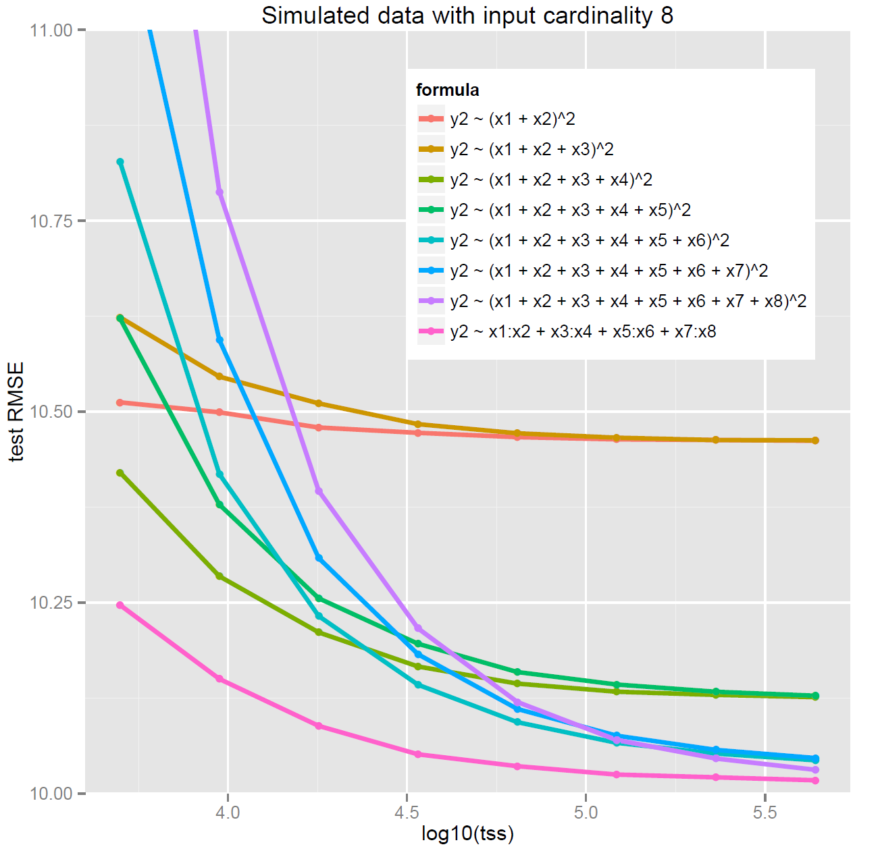

Slide 68
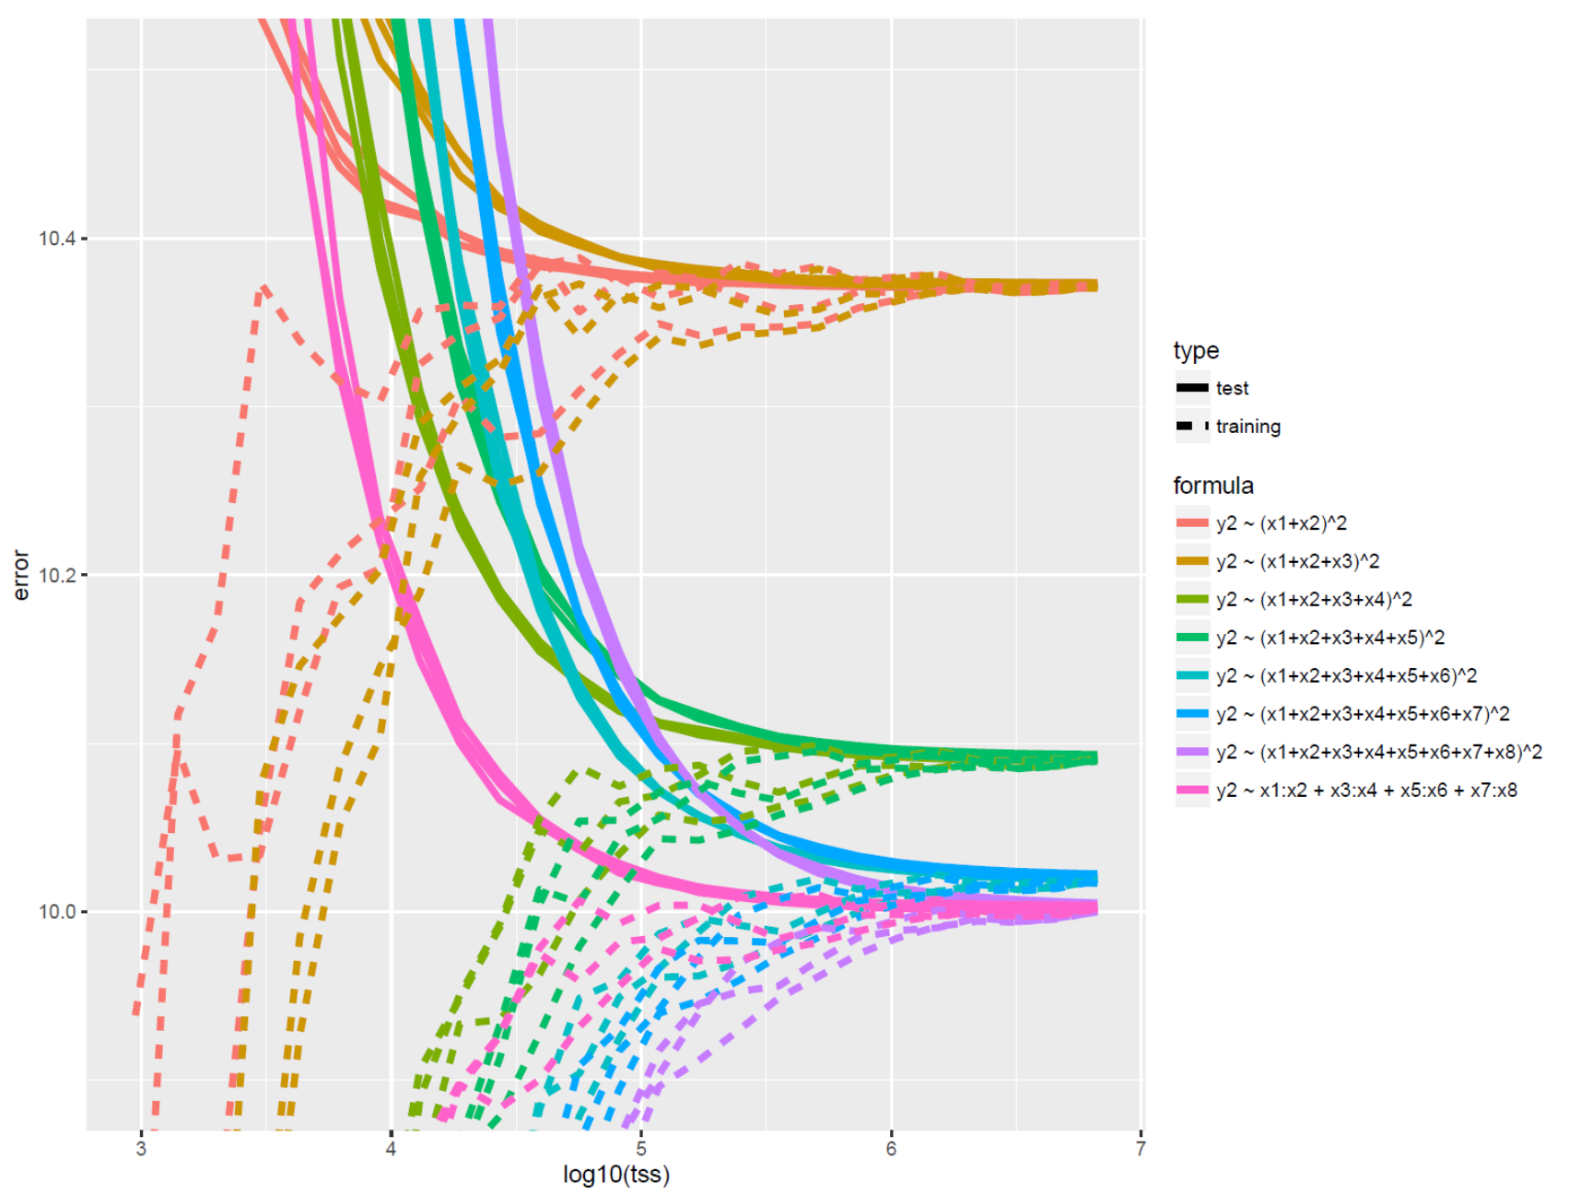
Simulated data
input cardinality 10
10M rows

Slide 69
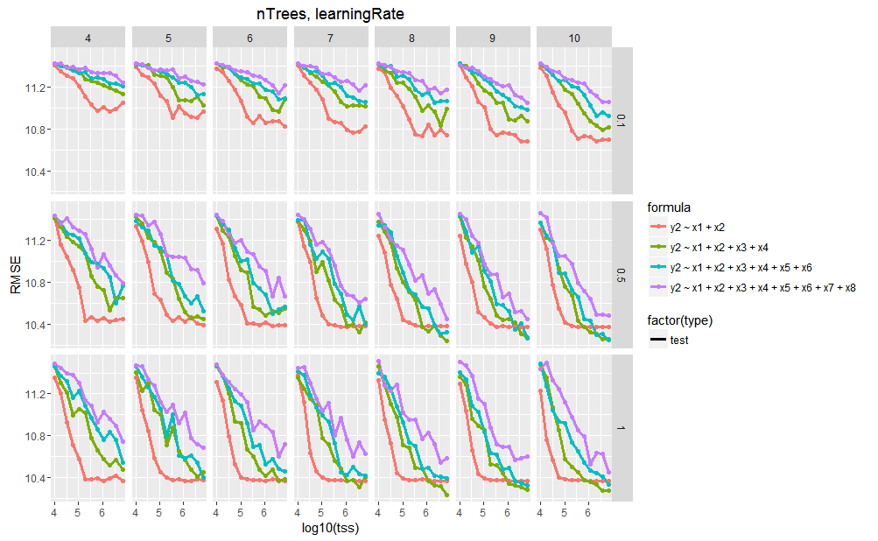
Tuning Boosted Trees

Slide 70
Examples with Real Data

Slide 71
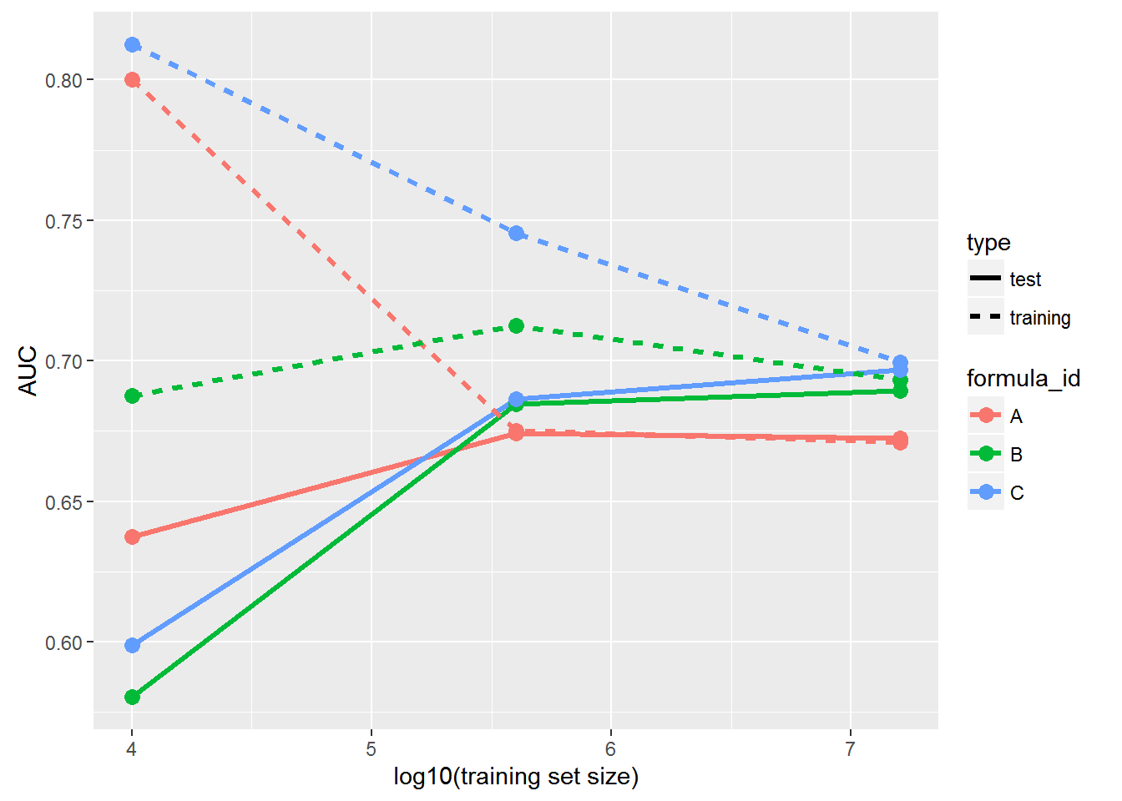
rxDForest

Slide 72
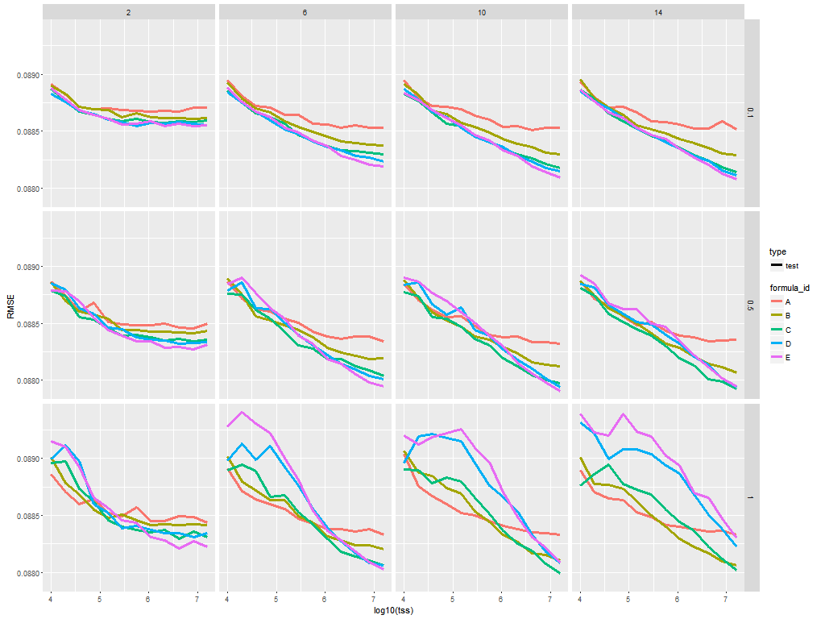
rxBTrees
maxDepth vs learningRate

Slide 73
Overview of open libraries of R templates and examples
2016
Katherine Zhao
Microsoft

Slide 74
Overview of open libraries of R templates
Tutorial material and slides are available: tinyurl.com/KDD2016R
R Server for Machine Learning examples: tinyurl.com/2016MRS4ML

Slide 75
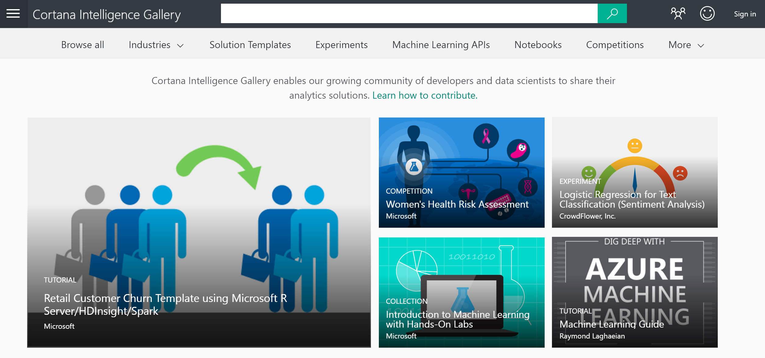
Cortana Intelligence Gallery

Slide 76
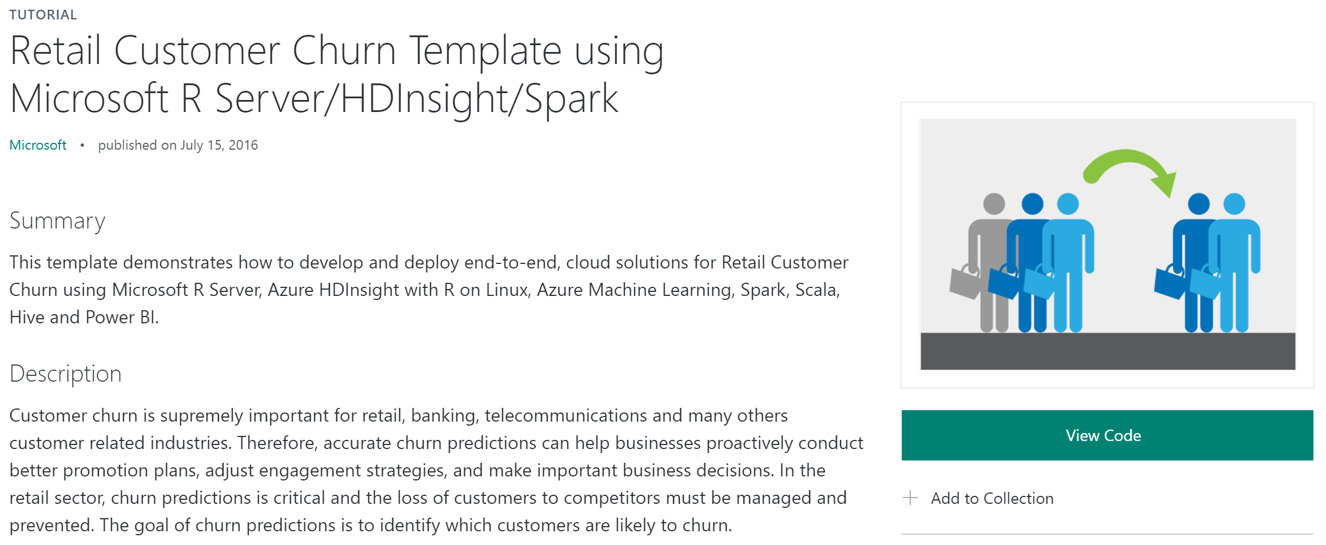
An end-to-end solution with R Server and Spark

Slide 77








Scale on big data - R Server + Azure
Data Streaming
Data Sources
Data Partition
Model Training
Web Services
Consumption
Feature Engineering
Predictions
HDInsight
Web Application
Azure Stream Analytics
Azure Blob Storage
Microsoft R Server
Azure Machine Learning
Power BI

Slide 78
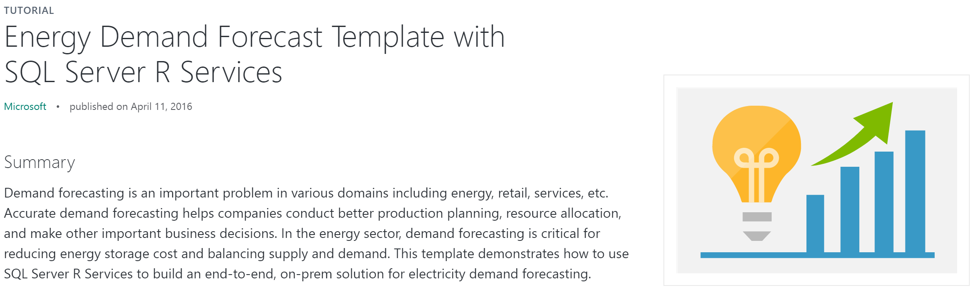
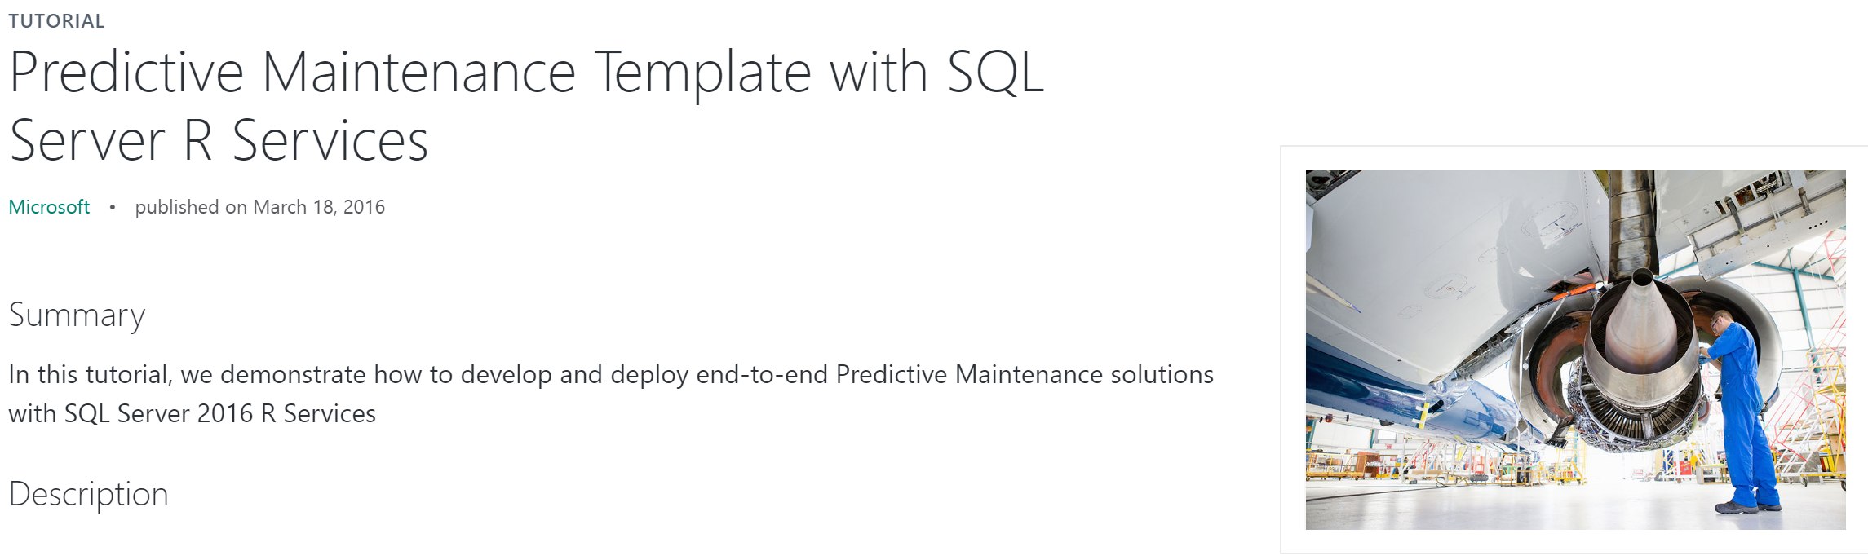
End-to-end solutions with SQL Server R Services

Slide 79
Q&A

Slide 80
THANK YOU

